Slide 1
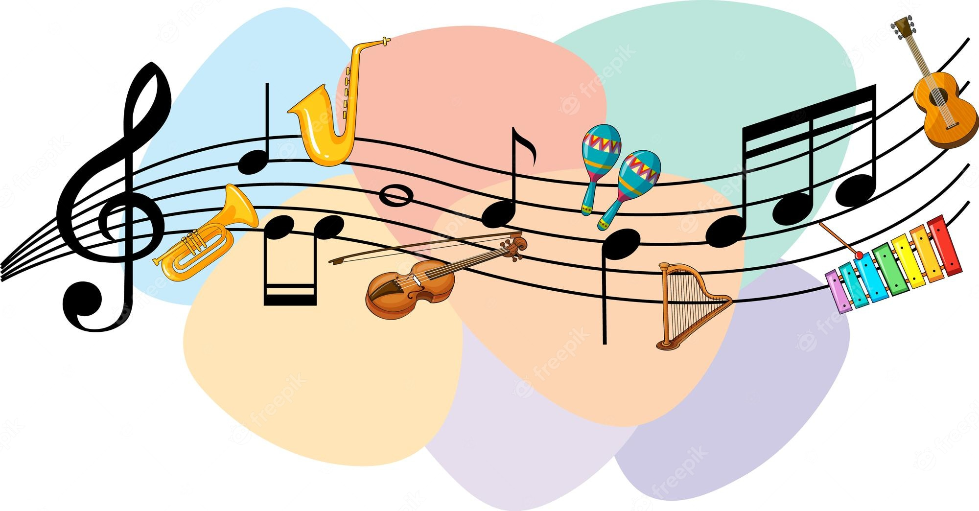


PROJECT REPORT ON “GENERATIVE MUSIC BASED ON TRANSFORMER ARCHITECTURE” Submitted in partial fulfillment for the award of MASTER OF COMPUTER APPLICATIONS DEGREE
UNDER THE GUIDENCE OF
Dr. Awaneesh Gupta (HOD)
SUBMITTED BY: ANANDITA KUMARI COURSE: MCA SECTION: A UNIVERSITY ROLL No.: 2200110140019
SUBJECT CODE: KCA-451
UNITED INSTITUTE OF MANAGEMENT (011)
(AFFILIATED TO Dr. A.P.J. Abdul Kalam Technical University (APJAKTU), LUCKNOW)

Slide 2

CONTENTS
PROBLEM IDENTIFICATION
OBJECTIVES
REQUIREMENTS
ANALYSIS
DESIGNING AND OUTPUT
CODING AND TRAINING
TESTING REPORT
IMPLEMENTATON AND FUTURE SCOPE
BIBLOGRAPHY

Slide 3

PROBLEM IDENTIFICATION
Limited Creativity: Conventional music composition relies heavily on human creativity, leading to potential creative blocks.
Time-Consuming: Manual composition is labor-intensive and slow.
Subjectivity: Human biases influence the composition process, limiting diversity.
Resource Intensive: Significant time, expertise, and equipment are required.

Slide 4
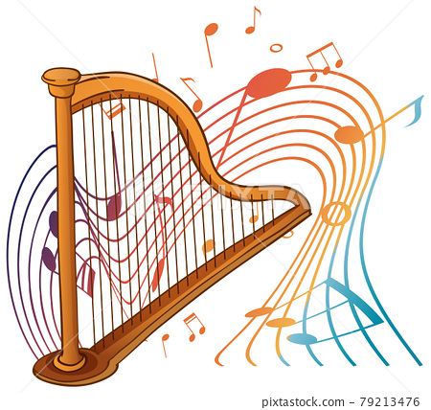
OBJECTIVE
Generate Music: Create music based on user input or text.
Study Transformer Architecture: Understand its application in music generation.
Future Prospects: Explore the future of AI-driven music composition.

Slide 5

REQUIREMENTS
Hardware Requirements
Speaker
Computer or device with sufficient processing power
GPU RAM: 8 GB
Software Requirements
Google Colab
Python libraries: PyAudio, sound device
Audiocraft for audio processing
Transformer Model :single-stage auto-regressive Transformer model

Slide 6

ANALYSIS
Existing Methods
Rely on human creativity
Time-consuming and subject to creative blocks
Proposed System
Utilizes Transformer architecture for real-time, innovative compositions
Autonomously generates diverse musical styles

Slide 7
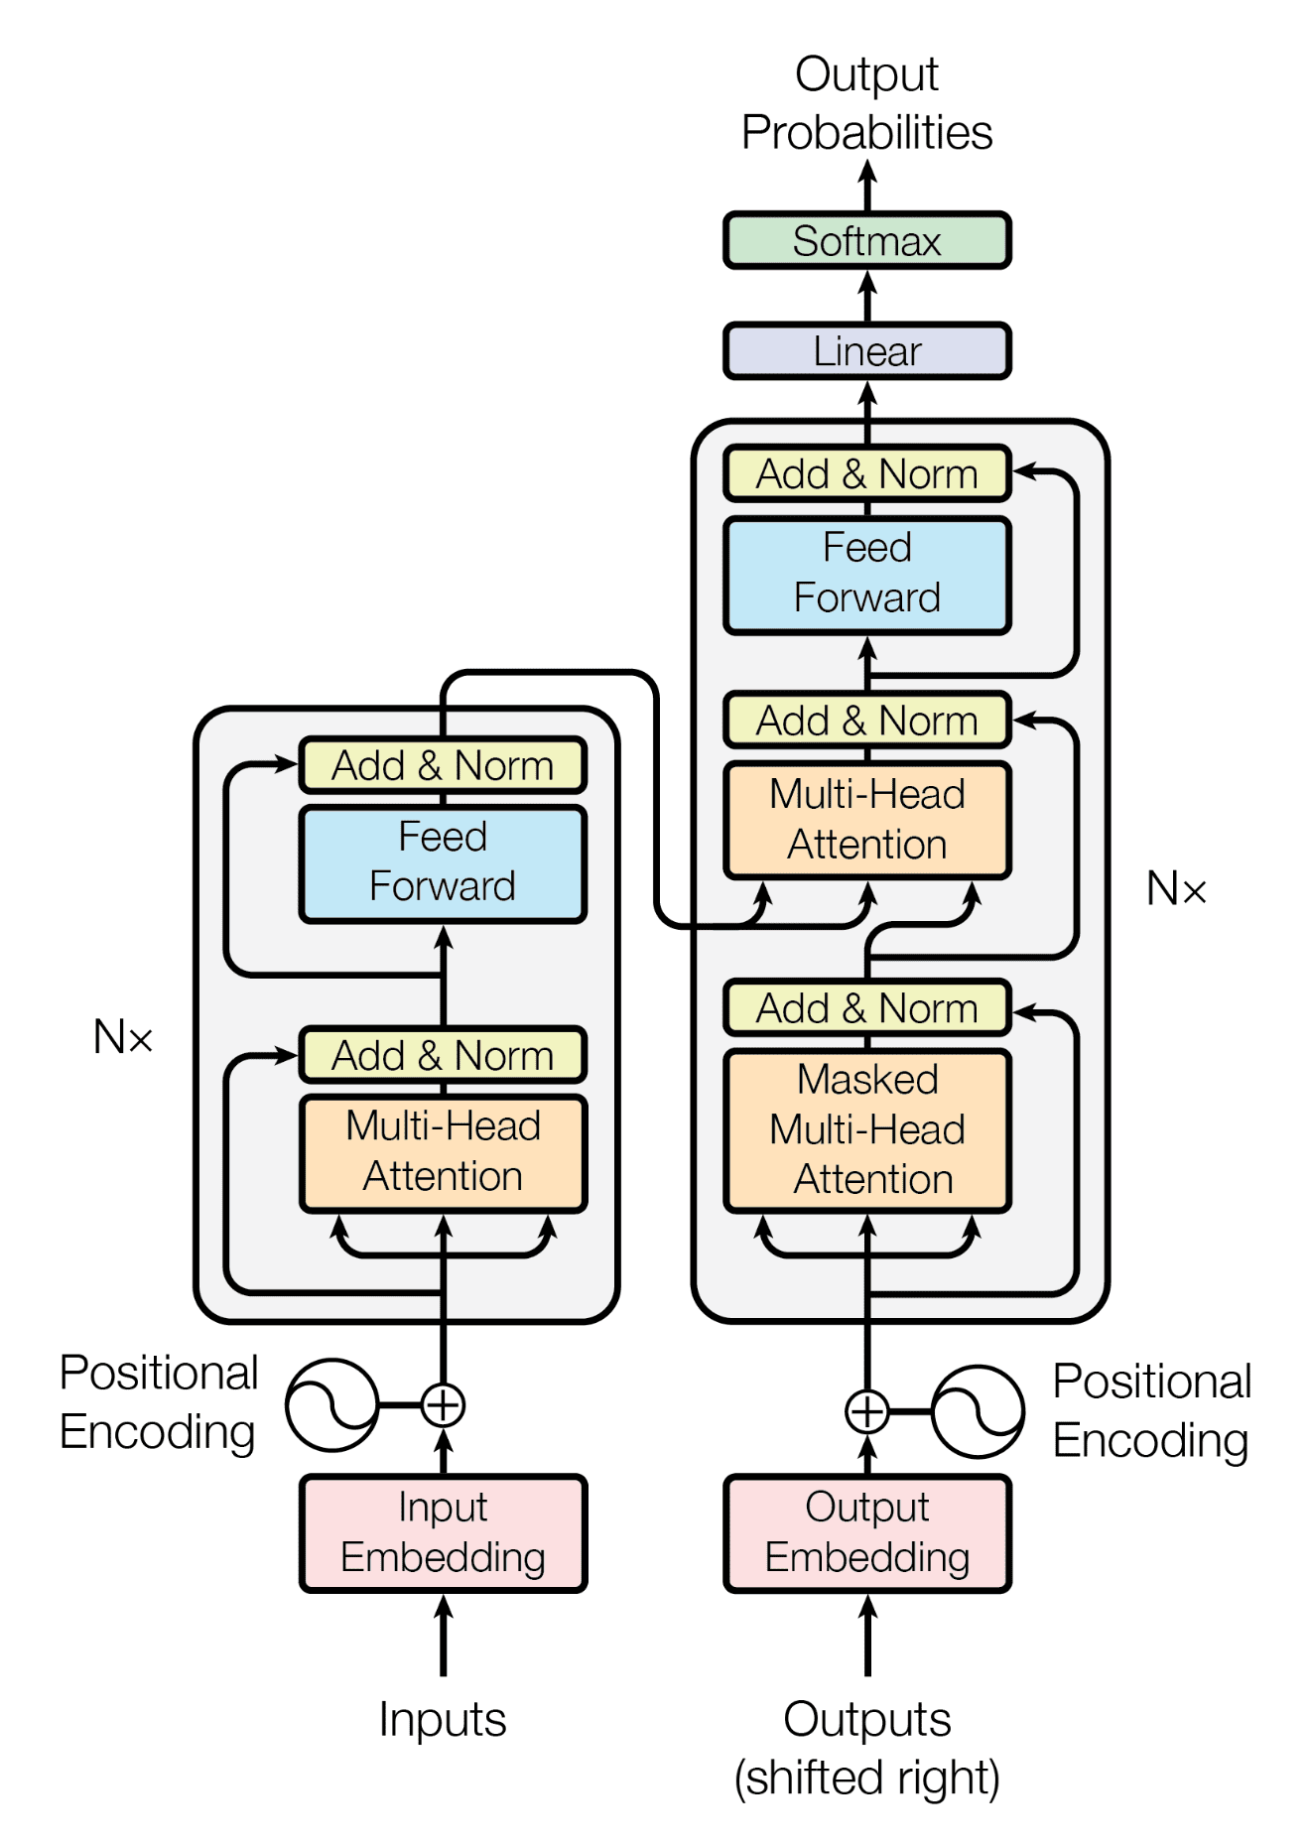
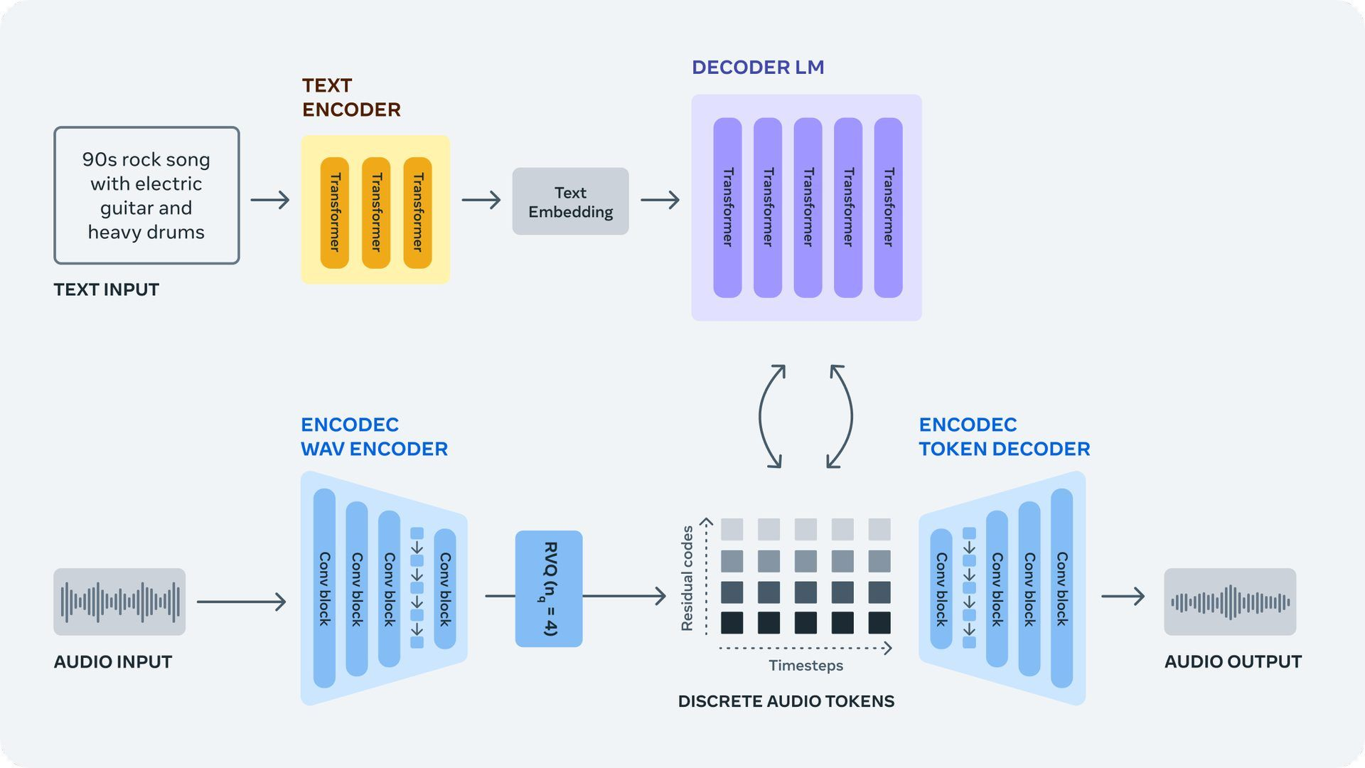
DESIGNING AND OUTPUT
Music Generator and Transformer Diagram
DATABASE

Slide 8
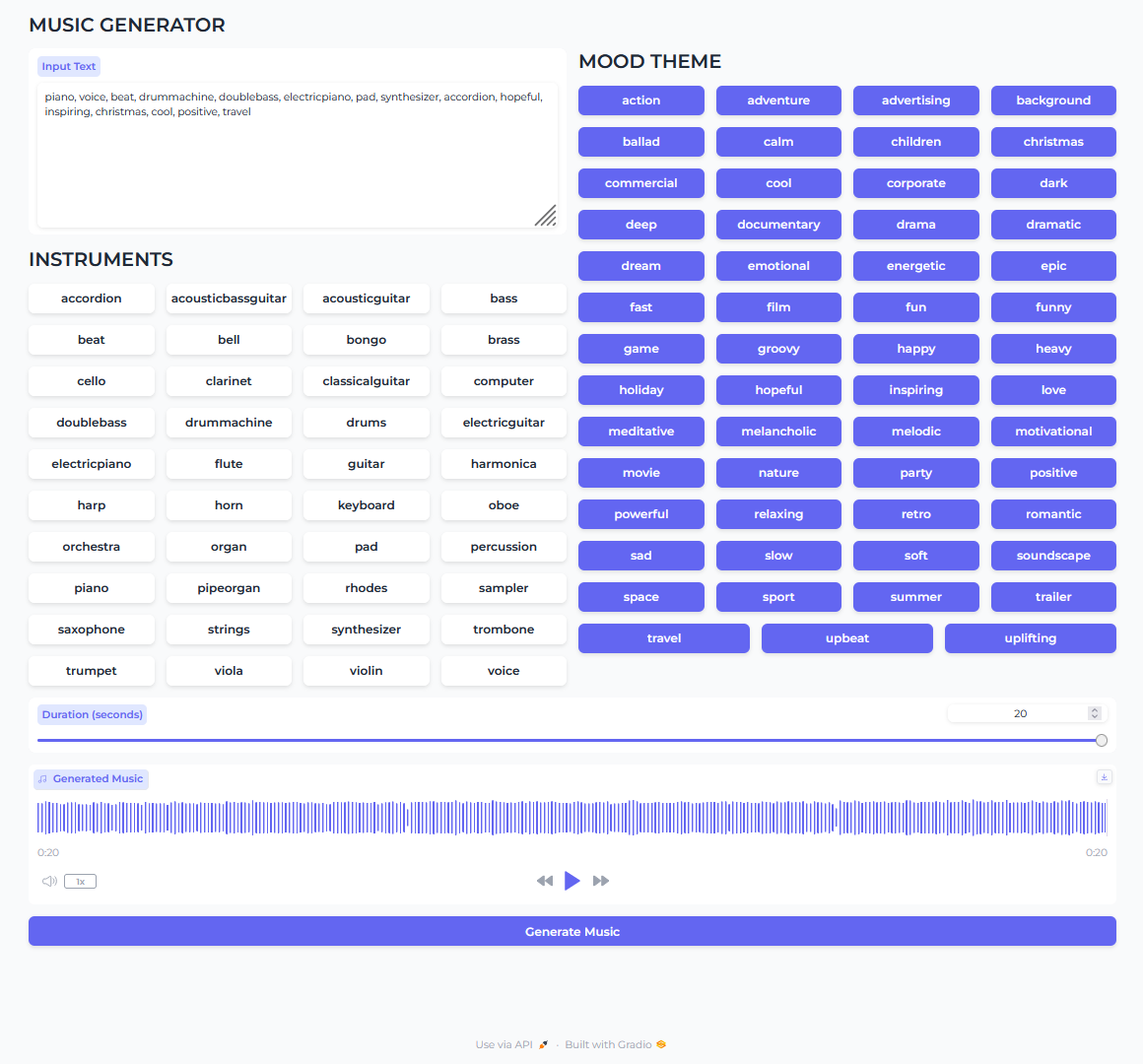
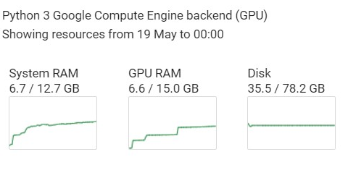
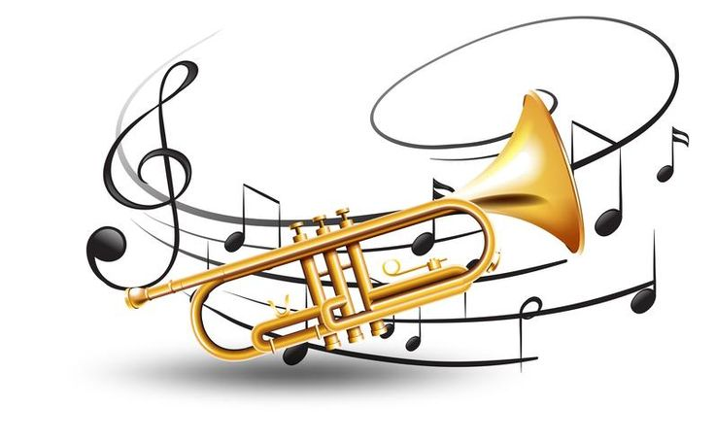
DESIGNING AND OUTPUT

Slide 9




CODING AND TRAINING
Python Programming: Implementation of the Transformer model in Python.
Google Colab: Leveraging GPU resources for model training.
Libraries: Using TensorFlow for deep learning tasks.

Slide 10

TESTING
Real-Time Interaction: Verifying system response to user inputs.
Performance Evaluation: Measuring the quality and coherence of generated music.
Bug Fixing: Identifying and resolving any issues during the testing phase.

Slide 11

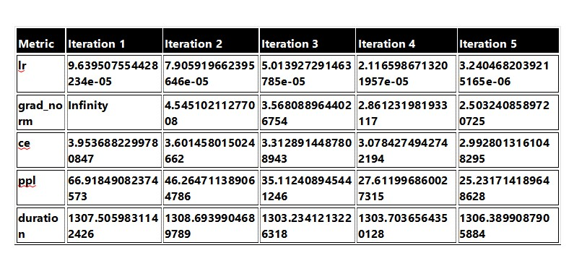
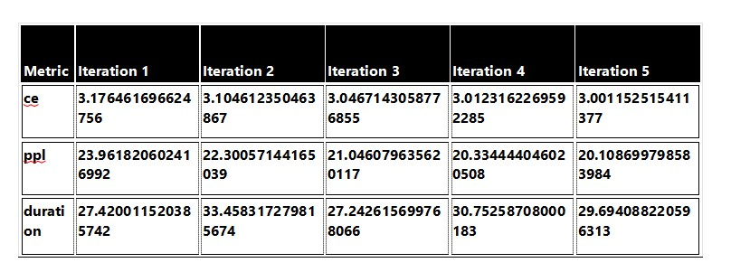
TRAINING AND VALIDATION DATA SUMMARY
TRAIN DATA SUMMARY
VALIDATION DATA SUMMARY

Slide 12
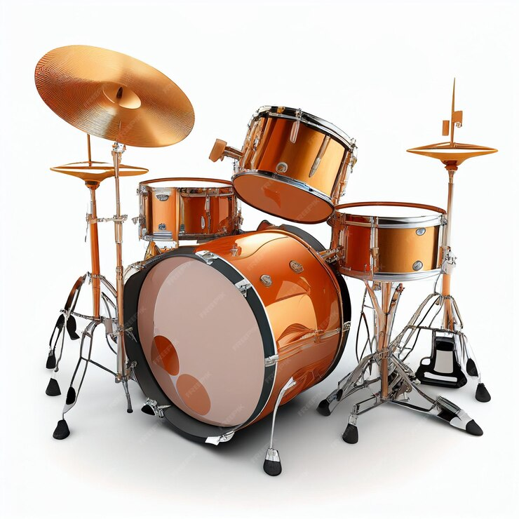
TRAINING REPORT
Training Phase Averages
Average Learning Rate (lr):5.00 x 10⁻⁵
Average Gradient Norm (grad_norm): 3.37
Average Cross-Entropy Loss (ce): 3.39
Average Perplexity (ppl): 40.23
Average Duration:1305.91 seconds

Slide 13
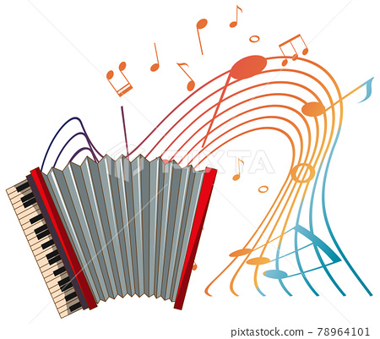
VALIDATION REPORT
Validation Phase Averages
Average Cross-Entropy Loss (ce): 3.07
Average Perplexity (ppl): 21.55
Average Duration: 29.71 seconds

Slide 14
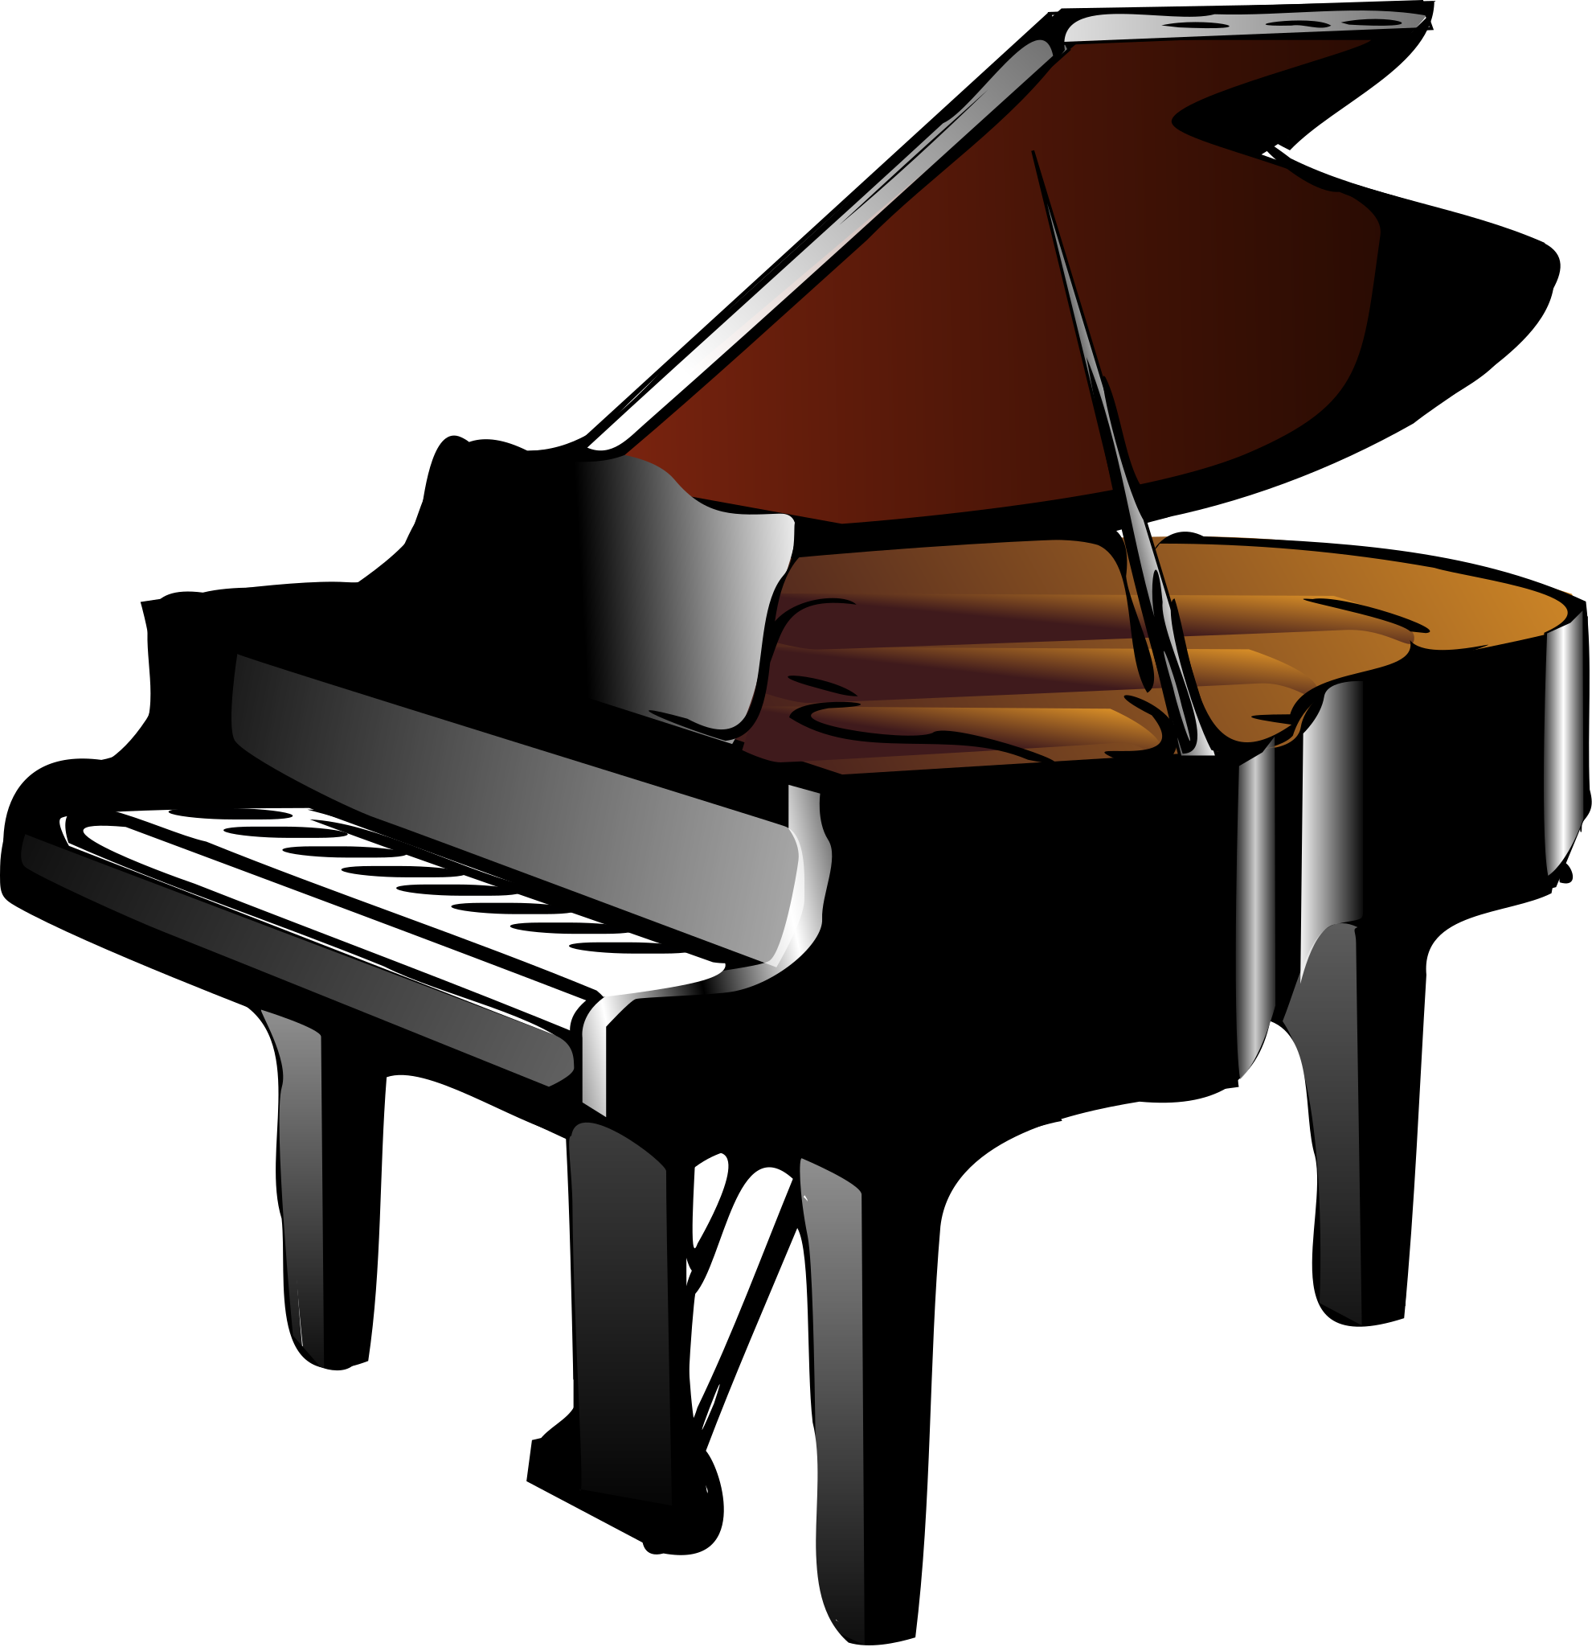
IMPLEMENTATION AND FUTURE SCOPE
Current Implementation: Integration with Audiocraft for enhanced audio quality.
Future Prospects: Exploring applications in live performances, gaming, and multimedia.
Continuous Improvement: Adapting to new technologies and expanding musical styles.

Slide 15
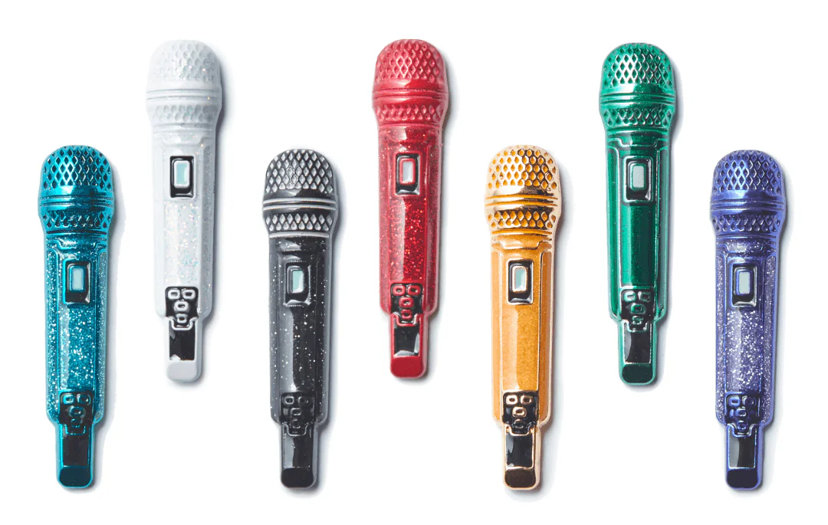
THANK YOU

